Slide 1
WATER LEVEL DETECTION SYSTEM USING IOT
Group Members:-
Ankur Sachan
Anubhav Srivastava
Akshat Tiwari

Slide 2
OBJECTIVE
To check the percentage of water filled in tank using Ultrasonic sensor.

Slide 3
INTRODUCTION
These days almost all the technologies uses some kind of computer based control system.
In this computer system are used to control hardware in flexible way.
These control systems can be implemented for optimizing the river flow in order to minimize the flood caused by the water overflow.
The aim of this project is to develop a prototype of water level detection that can be viewed as a part of river flow management system.

Slide 4
FEASIBILITY STUDY
All the equipment required are available easily and it is very cost effective.
It is not affected by weather because it is installed inside the tank.
Very effective in order to check the water level in real time.
The only human effort required is for installation.

Slide 5
LITERATURE REVIEW
NPTEL for IoT lectures
Research papers on water level detection system from:
IEEE
Research gate

Slide 6
TECHNOLOGY
The Internet of Things (IoT) refers to a system of interrelated, internet-connected objects that are able to collect and transfer data over a wireless network without human intervention.

Slide 7
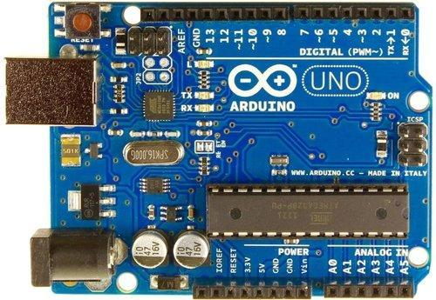
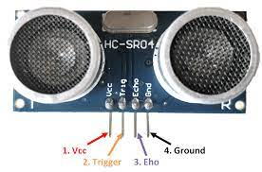
HARDWARE / SOFTWARE REQUIRED
ARDUINO UNO R3 Microcontroller Board
ULTRASONIC SENSOR
5V ADAPTER
JUMPER WIRE
LAPTOP
AC 220V 50 Hz
ARDUINO IDE
PROCESSING IDE

Slide 8
CODING
const int trigPin = 7; const int echoPin = 8; long duration; int distanceCm1; int distanceCm; int d; int e;
void setup()
{ pinMode(trigPin, OUTPUT); pinMode(echoPin, INPUT); Serial.begin(9600); Serial.print("Welcome to the water level detection System"); }

Slide 9
void loop()
{ digitalWrite(trigPin, LOW); delayMicroseconds(2); digitalWrite(trigPin, HIGH); delayMicroseconds(10); digitalWrite(trigPin, LOW); duration = pulseIn(echoPin, HIGH); distanceCm1=18; distanceCm= duration*0.034/2; d=distanceCm1-distanceCm; e=d*100/distanceCm1; Serial.print("Percentage of the water filled:"); Serial.println(e); delay(1000); }

Slide 10
CONCLUSION
Prototype of Water Level Detection System has been tested and reasonably good performance is shown based on the test result. The main contribution of this performance is the ultrasonic sensor calibration by adjusting calculation of distance based on an actual data.
The water level data is successfully displayed locally or remotely, therefore this prototype can be used as a part of the bigger system, such as, river flow management system which controls the stream to minimize the flood.
The receiver acts as a water level data feeder that can be transmit the data remotely to the server.

Slide 11
FUTURE SCOPE
River flow management system
It can also be implemented in:
Agricultural fields
Overhead tanks

